Slide 1

OpenShift 4 Hybrid-Multi Cloud Demonstration — Deron Ringen Infrastructure Architect

Slide 2
Agenda
OpenShift 4 Overview
OpenShift 4 Install
Hybrid – Multi Cloud Setup
Network Policies Demo

Slide 3
Agenda
OpenShift 4 Overview

Slide 4
So what is OpenShift 4?
“OpenShift is a family of containerization software developed by Red Hat. Its flagship product is the OpenShift Container Platform—an on-premises platform as a service built around Docker containers orchestrated and managed by Kubernetes on a foundation of Red Hat Enterprise Linux.”
In other words, OpenShift is a front-end application that sits on top of Kubernetes and provides a UI, datastore and additional APIs to Kubernetes.
OKD is the Opensource version of OpenShift.

Slide 5


OpenShift enables the power of Kubernetes (i.e. containers) in a hybrid-multi cloud environment.
With OpenShift your control plane can run in the cloud or datacenter.
Your workloads (containers) can run in the cloud or datacenter.
Your workloads can be moved from the datacenter to cloud or cloud to datacenter as needed based on capacity, functionality or cost.

Slide 6
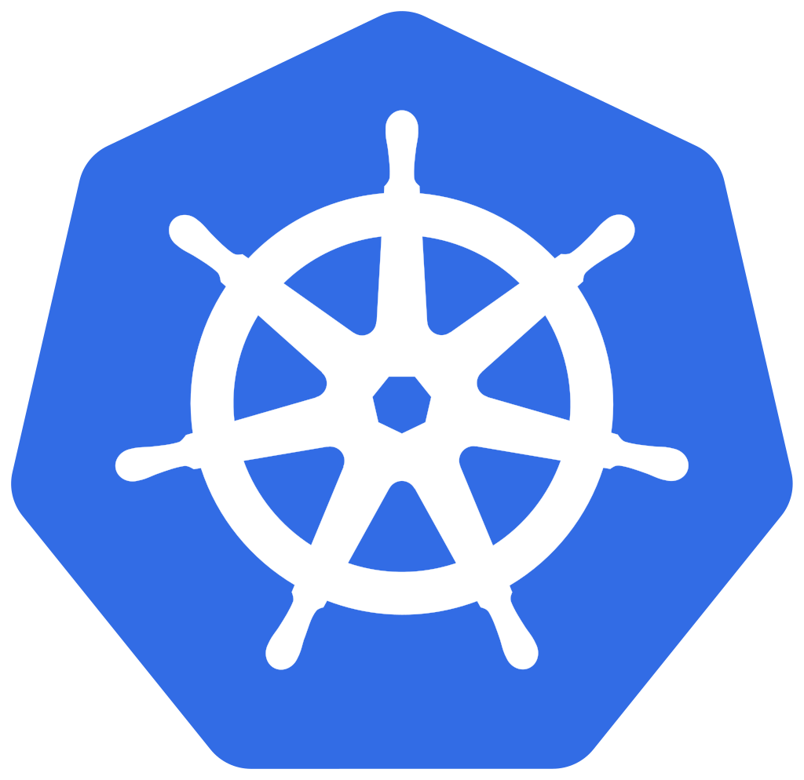

So why use OpenShift as opposed to just Kubernetes?
They both can accomplish the task of running containers in hybrid-multi cloud environments.
It comes down to ease of management and ease of developing & running apps.
OpenShift 4 manages the full stack by using Redhat CoreOS
Packages are preinstalled in OpenShift and are easy to add.
OpenShift includes a very functional UI.
End users can fully launch applications via the UI.
Autoscaling accommodates the load demands of applications
Kubernetes is mainly cli. The UI is for viewing status, not launching resources or applications.
Adding or integrating other packages is a manual process.
End user must know Kubernetes cli and yaml/json configuration.

Slide 7
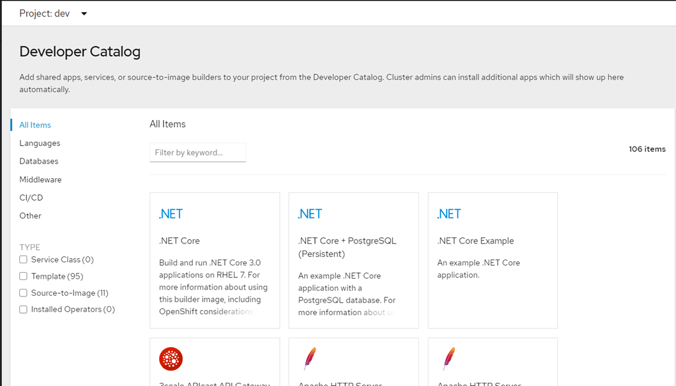
Application Packages are pre-installed and accessed via the Developer Catalog

Slide 8
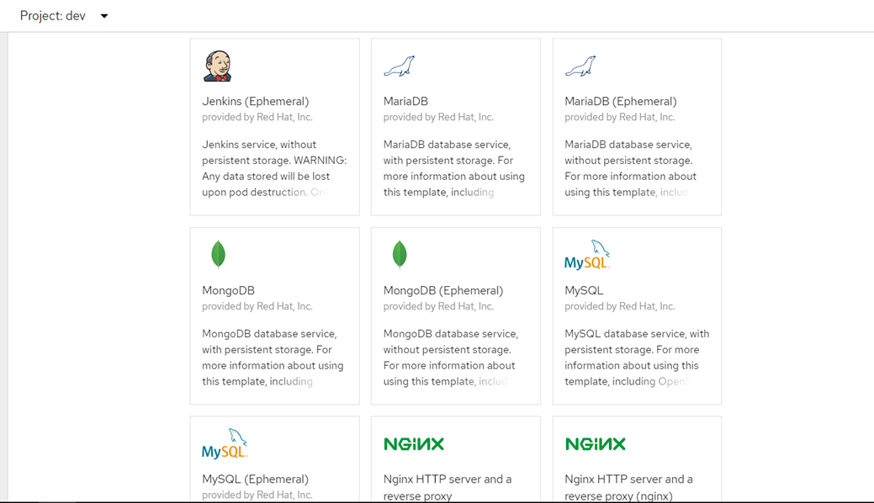
Application Packages are pre-installed and accessed via the UI Developer Catalog Cont….

Slide 9
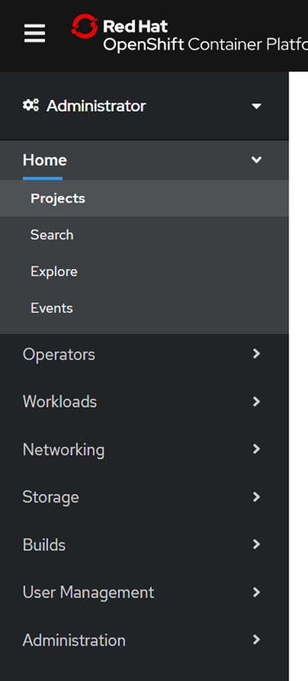
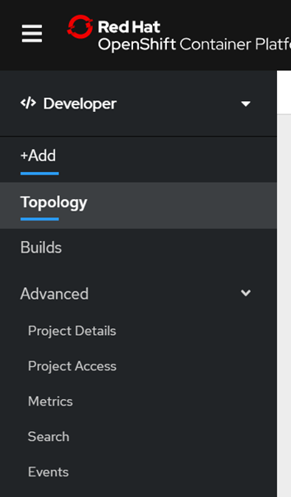
Each user has two “views” via the UI. “Administrator” and “Developer”
Administrator View
Access to:
Workloads
Operators
Networking
Storage
Developer View
Access to:
Topology
Build
Projects

Slide 10
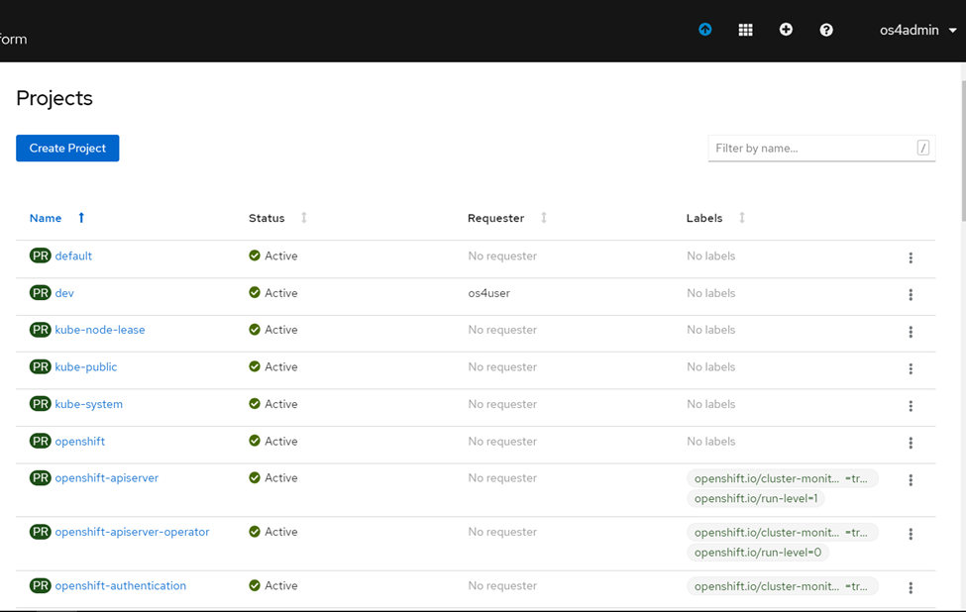
Each user is only able to access the “Projects” that they have created or have been assigned to.
User “os4admin” assigned OpenShift role of “Cluster Administrator”
os4admin has access to projects:
All projects to include the OpenShift projects.

Slide 11
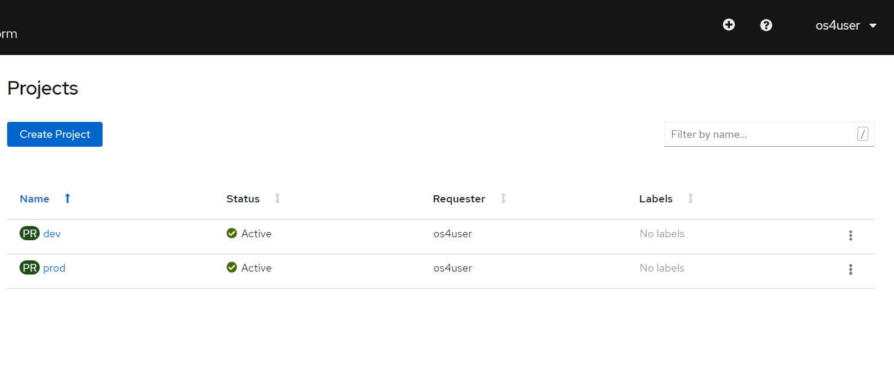
Each user is only able to access the “Projects” that they have created or have been assigned to. Cont…
Users “os4user” assigned OpenShift role of “Basic User”
os4user has access to projects:
dev
prod

Slide 12
I hear about OpenShift 3, so what is the difference between OpenShift 3 and OpenShift 4?
For the developer OpenShift 4 includes more items in the “Developer Catalog”.
For the administer OpenShift 4 manages the full stacks
Utilizes Redhat CoreOS for full management of the underlying operating system.
For administers OpenShift 4 supports “Auto Scaling” of workloads.
Spinning up and down of worker nodes to accommodate the demands of the applications.
All new features are being done on OpenShift 4. OpenShift 3 is capped.

Slide 13
Agenda
OpenShift 4 Overview
OpenShift 4 Install

Slide 14
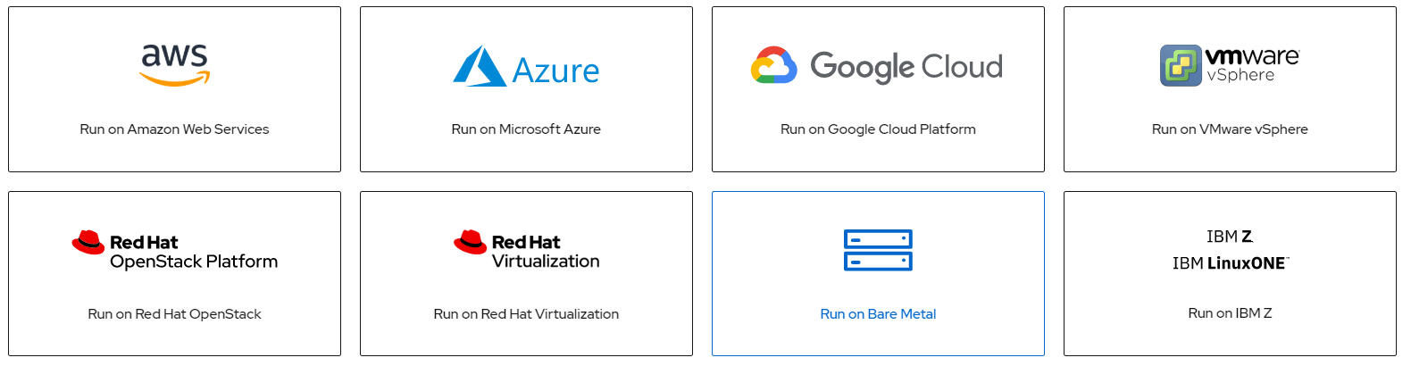
OpenShift 4 can be deployed on a number of cloud providers and on-premise environments
“Bare Metal” really covers any physical or virtual environment where you can install Redhat Core OS.

Slide 15
OpenShift 4 has two distinct installation models. Installer Provisioned Infrastructure (IPI) & User Provisioned Infrastructure (UPI)
With the IPI model the OpenShift installer application creates and totally manages the all required nodes (masters & workers).
As easy as “openshift-install create cluster”.
Additional nodes are created & added (think auto-scaling) to the cluster via the OpenShift auto-scaler, cli or UI.
Supported on IBM Cloud, Azure, AWS, Google, VSphere, Openstack, Redhat Virtualization
Everything but the external DNS is created, installed, and managed by OpenShift
With the UPI model the user (i.e. customer) creates and manages the physical or virtual machines that OpenShift is installed on.
This includes the masters, workers, bootstrap, external DNS and load balancers.
Additional nodes are manually created by the cluster administer.
The master nodes require Red Hat Core OS (RHCoreOS).
Worker nodes can be either RHCoreOS or RHEL.

Slide 16
Minimal Requirements for OpenShift 4 Installation

Slide 17
OpenShift 4 Installation Steps
IPI Installation Steps - 3 Steps
Create DNS records in the external DNS system.
Create install-config.yaml (Only on some platforms)
Run “OpenShift-install create cluster”.
UPI Installation Steps – 15 Steps
Create DNS records in the external DNS system
Create and configure load-balancer
Create and configure http server
Create DNS Server/Entries
Create http server for ignition files
Create install-config.yaml file
Create OpenShift-install ignition files
Load ignition files on http server
Load rhcos "raw" image on http server
Create rhcos VMs via .iso boot image
Boot bootstrap rhcos VMs & set ignition variables
Boot master(s) rhcos VMs & set ignition variables
Boot worker(s) rhcos VMs & set ignition variables
Verify bootstrap completion
Approve CSR for machines

Slide 18
OpenShift 4 Installation – UPI Post Installation Steps
Steps to be completed before end users can use the new cluster.
Create an Authentication Operator
Used for end user authentication
Options are: HTPasswd, Keystone, LDAP, Google, GitHub, GitLab, OpenID
Create Storage for Image Registry
Persistent storage to be used for the image registry.
Options are: Amazon EFS, AWS Elastic Block Store, Azure Disk, Azure File, Cinder, Container Storage Interface (CSI), Fibre Channel, FlexVolume, GCE Persistent Disk, hostPath, iSCSI, local volumes, NFS, Red Hat OpenShift Container Storage, vSphere
Configure Image Registry to use storage.

Slide 19
Agenda
OpenShift 4 Overview
OpenShift 4 Install
Hybrid – Multi Cloud Setup

Slide 20
OpenShift 4 Hybrid – Multi Demo Cloud Overview
One data center and two public clouds
Data Center
1 x OpenShift 4 Cluster master/worker
OpenShift 4 Cluster external DNS
OpenShift 4 Cluster external LB
OpenShift 4 Cluster storage
SD-WAN Router
IBM Cloud
2 x OpenShift 4 worker nodes
Internet Load Balancer
IBM VPN Gateway
Azure
1 x OpenShift 4 worker node
SD-WAN Router

Slide 21
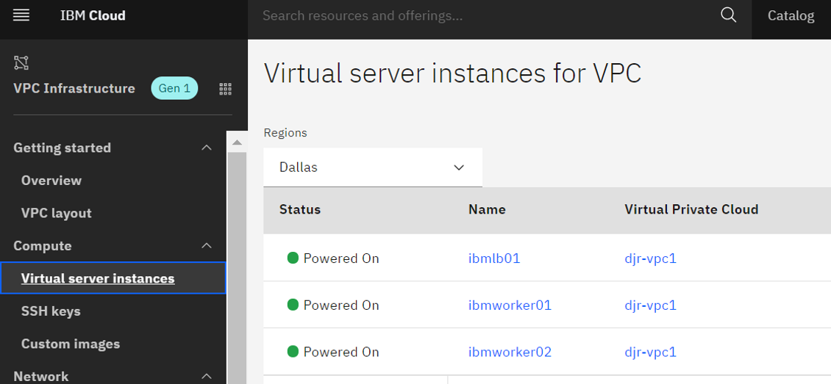
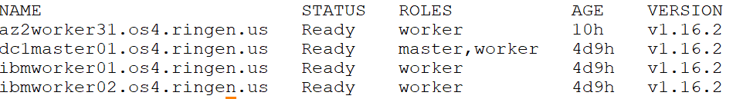
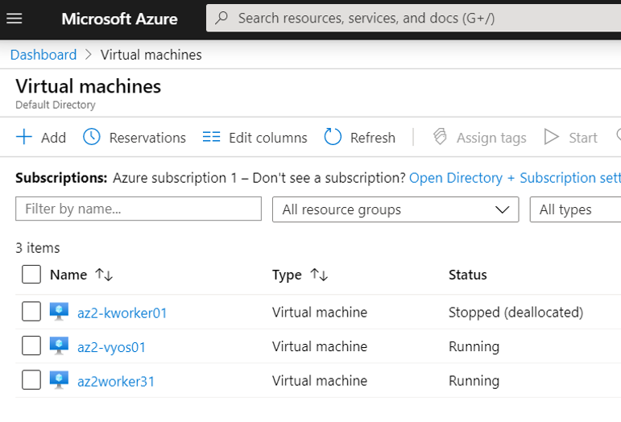
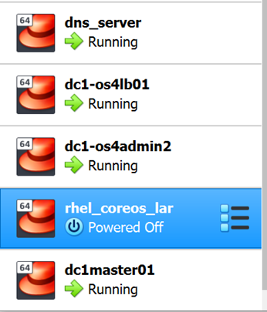
OpenShift 4 Hybrid – Multi Demo Cloud Overview – VMs Locations
IBM Cloud
oc get nodes
Azure
Data Center

Slide 22
OpenShift 4 Hybrid – Multi Demo Cloud Overview – Data Center
Data Center - dc1
Data Center
1 x OpenShift 4 Cluster master/worker
RH CoreOS
4 core / 22GB /120GB Disk
Infrastructure VM
CentOS
named, nfsd, httpd
1 core / 384MB
External Load Balancer VM
CentOS
2 core / 384MB
HAProxy
SD-WAN Router
VYOS
2 core / 384MB

Slide 23
OpenShift 4 Hybrid – Multi Demo Cloud Overview – IBM Cloud
IBM Cloud
IBM Cloud
2 x OpenShift 4 worker nodes
Redhat RHEL
2 core / 8GB
Internet Load Balancer
CentOS
2 core / 4GB
HAProxy
IBM VPC VPN Gateway
NATing to ibmlb01
IPSEC Session to:
Azure - az2vyos01
dc1 – dc1vyos01

Slide 24
OpenShift 4 Hybrid – Multi Demo Cloud Overview – Azure
Azure
Azure
1 x OpenShift 4 worker node
Redhat RHEL
2 core / 8GB
SD-WAN Router
VYOS
1 Core / 512MB

Slide 25
Internet Access for OpenShift 4 “web-1” Application – www-1.ringen.us
Multiple options to “ingress” traffic into an OpenShift 4 cluster
Cloud provider load balancer
Tight integration via an IPI cloud configuration.
Load balancer / Firewall / Router VM.
Load balancer / Firewall / Router appliance.
Multiple options to “forward” traffic to the correct pod(s)
OpenShift Ingress Controller (layer 6 router).
http/https only
OpenShift service
OpenShift pod or node IP
There are several factors in picking the right solution: Traffic type (http vs other). Environment (cloud vs prem vs IPI vs UPI). Design requirements (HA, performance). Traffic flow. Comfort level (using a solution that you are already familiar with). Cost.

Slide 26
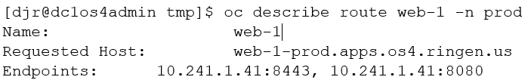
Internet Access for OpenShift 4 “web-1” Application – www-1.ringen.us cont…
In a hybrid-multi cloud environment traffic flow is a key factor. You do not want traffic bouncing from cloud-prem-cloud. You want to keep your ingress traffic close to your application/data and not take unnecessary hops. You want to control your traffic flow.
I chose to use a custom load balancer VM running in the IBM Cloud, along with the OpenShift Ingress Controller (os4 router pod).

Slide 27
OpenShift 4 Hybrid – Multi Cloud Demo Lessons Learned
UPI Installation
Really Really need to have at least 56GB of RAM for control plane VMs.
DNS and Load Balancer entries must be correct.
Redhat licensing and registration can be difficult.
IBM Cloud
Using the IBM VPC VPN Gateway connections are difficult to setup, due to lack of logging and debugging.
Cannot assign the host IP address to the VMs. A random IP from the subnet is assigned to the VM.
Adding worker nodes require resetting the VMs RHEL registration.
Azure
DNS integration is difficult, because the VMs DNS servers are (/etc/resolv.conf) are reset on boot-up. Had to add DNS entries into the Internet DNS.
Adding worker nodes require resetting the VMs RHEL registration.

Slide 28
Agenda
OpenShift 4 Overview
OpenShift 4 Install
Hybrid – Multi Cloud Setup
Network Policies Demo

Slide 29
Kubernetes / OpenShift Networking Overview

Slide 30
Kubernetes / OpenShift Networking Overview cont…
Key Points -
By default each worker does not know about the Pod subnets assigned to the other workers.
Hence a Network Plugin is required to enable IP connectivity of pods between worker nodes.
Referred to as a CNI. The default CNI for OpenShift 4 is OpenShift SDN.
OpenShift SDN –
Can leverage Kubernetes Network Policies.
- Network based security.
- Node level & application aware firewalls.
Overlay networking (VXLAN/GRE/GENEVE)
Based on OpenvSwitch

Slide 31
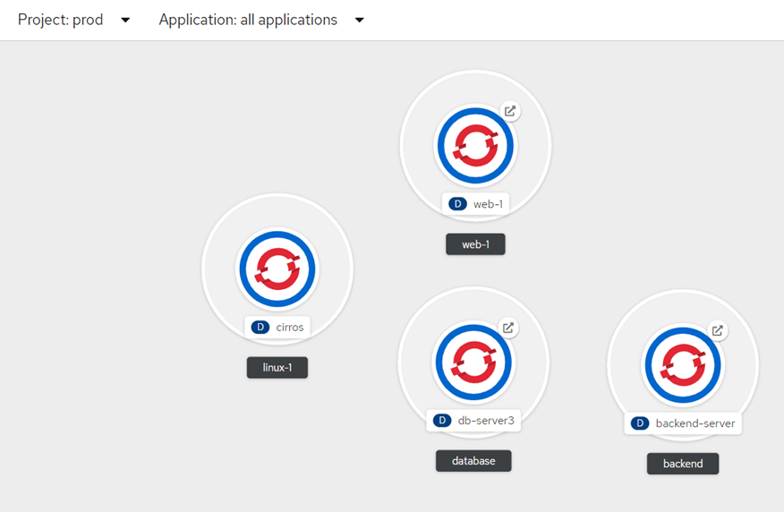
Production (prod) Project Topology
Three applications with one pod each -
Web-1 – External web interface
Backend – Backend application for web interface
Database – Database that accessed via Web interface.
Linux-1 (cirros) is for testing.

Slide 32
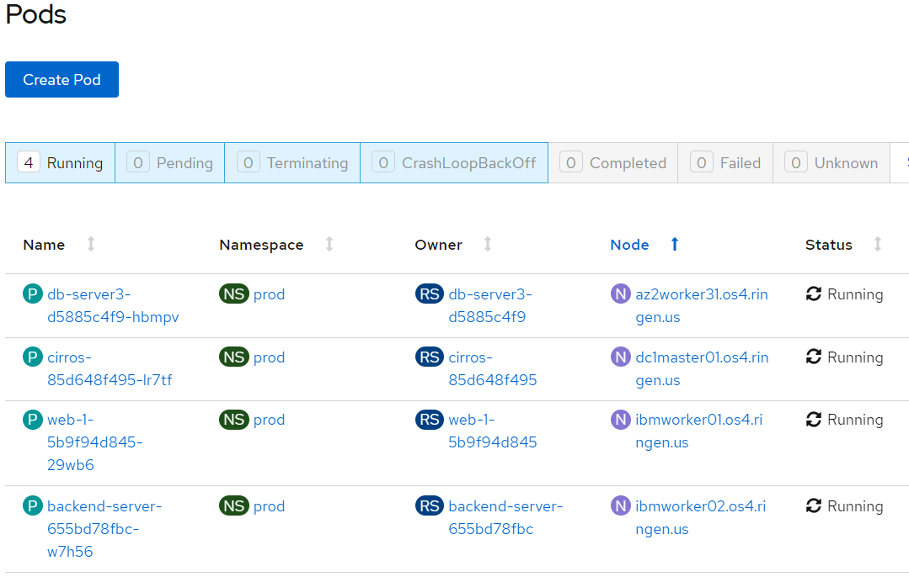
Pods in the Production (prod) Project
Each applications has a single pod-
Pod web-1-5b9f94d845-29wb6 on ibmworker01
Pod backend-server-655bd78fbc-w7h56 on ibmworker02
Pod db-server3-d5885c4f9-hbmpv on az2worker31

Slide 33
Production (prod) Project Service Traffic Flow
Default Traffic Flow –
Any app can communication with any app other app
Desired Traffic Flow –
web to database communications is blocked

Slide 34
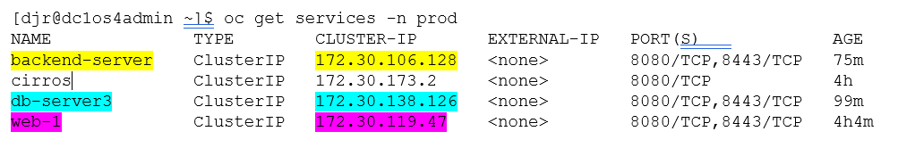
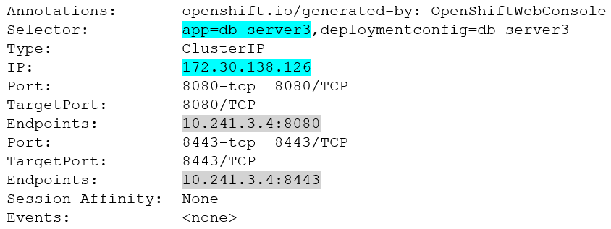
Default OpenShift 4 SDN Network-Policy is to allow any Pod to any Pod Communications within a project - Allow-All
One Service for each “application” listening of ports 8080/8443. Note: services names are mapped into the internal OpenShift DNS.
The db-server3 service
Maps a service IP/Port to and Endpoint IP/Port. Endpoint = pod.
The endpoint IP can change but the service IP stays the same.

Slide 35
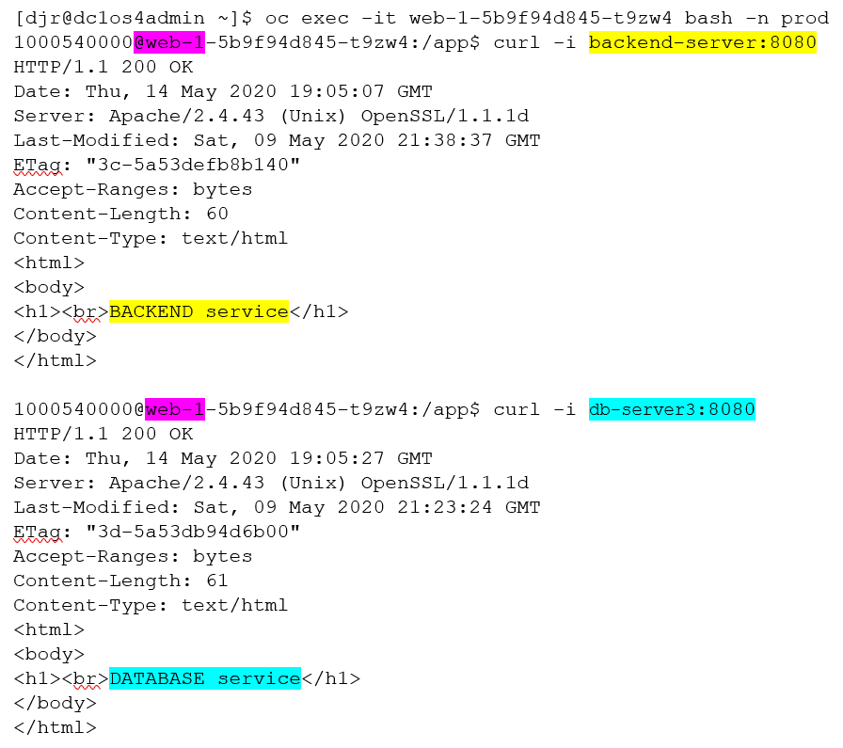
Default OpenShift 4 SDN Network-Policy is to allow any Pod to any Pod Communications cont…
Access the “web-1” pod via “oc exec”
From within the pod successfully connect to the “backend-server” and “db-server3” services via the “curl” commands.

Slide 36
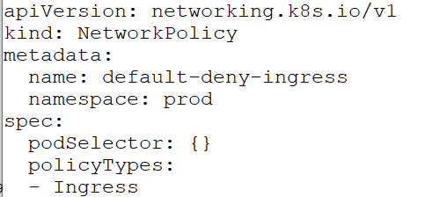
Create a Deny-All Network Policy to block all Ingress Traffic
OpenShift 4 SDN network policy only affects ingress traffic.
Works via a “whitelist” methodology, so traffic must be blocked first.
Create “default-deny-ingress” Network Policy
Matches on all pods in project/namespace “prod”
No matches for Ingress
Result is to block all ingress traffic

Slide 37
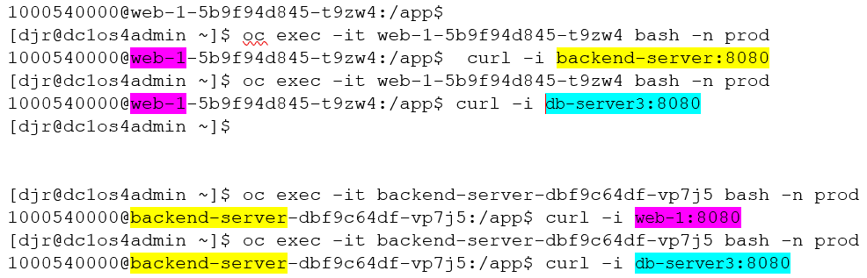
Create a Deny-All Network Policy to block all Ingress Traffic cont…
From within the web-1 pod connects blocked to the “backend-server” and “db-server3” services via the “curl” commands.
From within the backend-server pod connects blocked to the “web-1” and “db-server3” services via the “curl” commands.

Slide 38
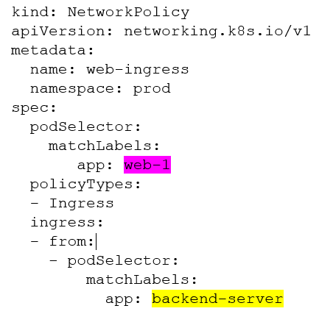
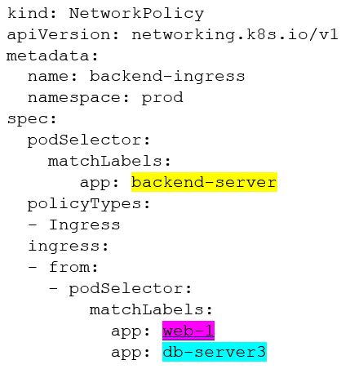
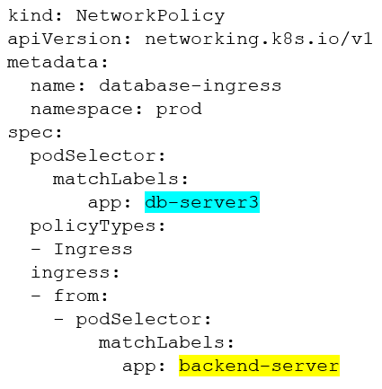
Create Network Policies to allow the desired service traffic flow
backend policy–
match “app: backend-server”
ingress from “app: backend-server & db-server3
web-1 policy–
match “app: web-1”
ingress from “app: backend-server
db-server3 policy–
match “app: web-1”
ingress from “app: backend-server

Slide 39
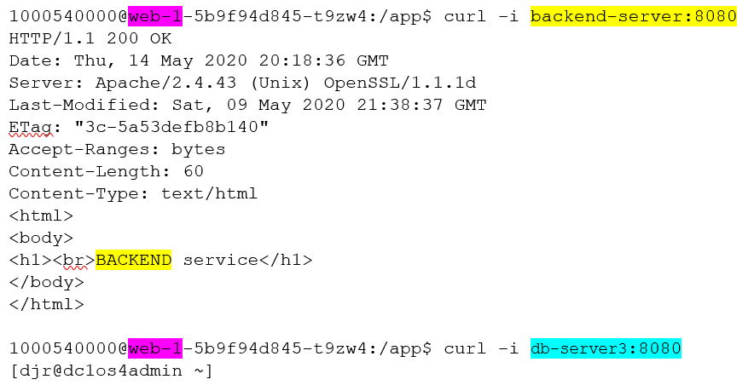
Create Network Policies to allow the desired service traffic flow - Results
Web service can communicate with the backend but not the database services.
From within the web-1 pod successfully connect to the “backend-server” service
From within the web-1 pod connection blocked to the “db-server3” service

Slide 40
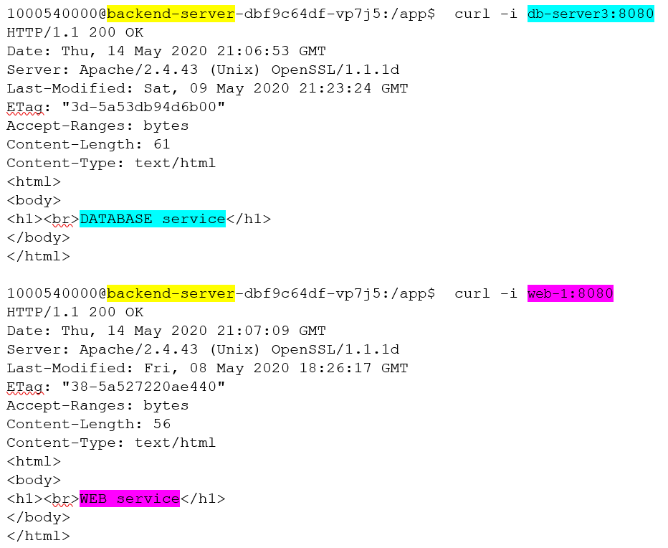
Create Network Policies to allow the desired service traffic flow - Results
Backend service can communicate with both the database and web services
From within the backend-server pod successfully connect to the “Database Service” service
From within the backend-server pod successfully connect to the “Web Service” service

Slide 41
Questions… Comments… Concerns… THANK YOU FOR YOUR TIME!!!

